Slide 1

Expectation Setting Overview
1
Subject: Full Stack Development-MERN
Sem : 6th Sem
Course Instructor: Mrs. Vijayasanthi M, Jayashree M , Shilpa Mangesh Pande
Notes:
1

Slide 2
Agenda
2
Introduction
Student perspective
Introduction to subject
Why subject is important
Real World Applications
Course Objectives
Pre-requisites
Course Outcomes
CO-PO mapping
Quiz
Textbooks and Reference books
Lesson Plan
Assessment Plan
Experience of past batch students
Expected classroom behavior
Some useful links

Slide 3
Introduction
3
Vijayasanthi Maddela
Assistant Professor, ISE Department
Email ID : vijayasanthi.m@cmrit.ac.in
Jayashree M
Assiociate Professor, ISE Department
Email ID : jayashree.m@cmrit.ac.in
Shilpa Mangesh Pande
Assistant Professor, ISE Department
Email ID :Shilpa.p@cmrit.ac.in

Slide 4
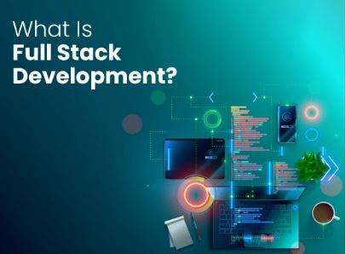
Students perspective
4
Students can introduce themselves
What is your expectation from this course ?

Slide 5
Introduction to subject
5
Full Stack Development requires a diverse skill set that spans both front- end and back-end technologies, as well as an understanding of the entire web development process from concept to deployment.
The FSD key Components:
Front-End Development (HTML, CSS, JavaScript) : Front-end development focuses on the user interface and user experience of a web application.
Back-End Development : It involves building the server-side logic and database management of a web application Reduce cognitive load
Databases (MongoDB, MySQL)
*

Slide 6
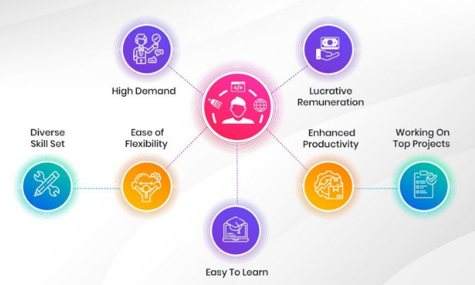
Why Full Stack Development is important?
6
let’s Understand..
Importance of the subject

Slide 7

Real-World Applications
7
Real-world applications examples:
E-Commerce Website and Application
Social Media Website and Application
Content Management System (CMS)
Online Chat Application
Task Management Tool
Blogging Platform
Online Learning Platform

Slide 8
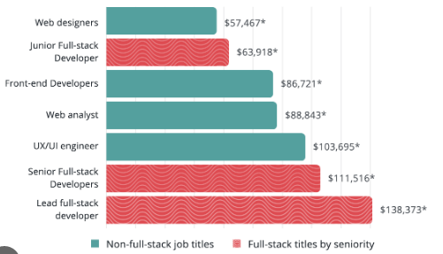
Job Opportunities/Placements
Job Roles:
  Devops Engineer
  Front-End Developer
  Back- end Developer
  Quality Assurance Engineer
  Web Developer
  Full Stack Developer
  Web Designer
  Mob App Developer

Slide 9
Course Objective
9
CLO 1. To understand the essential javascript concepts for web development. CLO 2. To style Web applications using bootstrap. CLO 3. To utilize React JS to build front end User Interface. CLO 4. To understand the usage of API’s to create web applications using Express JS. CLO 5. To store and model data in a no sql database

Slide 10
Prerequisite
10
Programming Basics: Understand fundamental programming concepts and have experience with languages like JavaScript, Python, or Java. Web Development Fundamentals: Familiarity with HTML, CSS, and basic knowledge of databases (DynamoDB) is essential. Version Control and Problem-Solving: Proficiency with version control systems like Git, along with strong problem-solving skills, are valuable assets for navigating real-world projects.

Slide 11
Quiz on Cos/expectation setting
11
What are different frontend technologies you worked on?
What are the stages in software development life cycle?

Slide 12
Text books and Reference books
12
Text Books
Jon Duckett, "JavaScript & jQuery: Interactive Front-End Web Development", Wiley, 2014.
2. Vasan Subramanian, Pro MERN Stack: Full Stack Web App Development with Mongo, Express, React, and Node. Apress, 2019.

Slide 13
Syllabus:Module-1: Basic JavaScript
13
Basic JavaScript Instructions, Statements, Comments, Variables, Data Types, Arrays, Strings, Functions, Methods & Objects, Decisions & Loops.
Text Book 1: Chapter 2, 3, 4

Slide 14
Module-2: Document Object Model:
14
Document Object Model: DOM Manipulation, Selecting Elements, Working with DOM Nodes, Updating Element Content & Attributes, Events, Different Types of Events, How to Bind an Event to an Element, Event Delegation, Event Listeners.
Text Book 1: Chapter: 5, 6, 13

Slide 15
Module-3: React Components
15
Form enhancement and validation. Introduction to MERN: MERN components, Server less Hello world.
React Components: Issue Tracker, React Classes, Composing Components, Passing Data Using Properties, Passing Data Using Children, Dynamic Composition.
Text Book 2: Chapter 1, 2, 3

Slide 16
Module-4: React State and Express
16
React State: Initial State, Async State Initialization, Updating State, Lifting State Up, Event Handling,
Stateless Components, Designing Components, State vs. Props, Component Hierarchy, Communication, Stateless Components.
Express, REST API, GraphQL, Field Specification, Graph Based, Single Endpoint, Strongly Typed,
Introspection, Libraries, The About API GraphQL Schema File, The List API, List API Integration,
Custom Scalar types, The Create API, Create API Integration, Query Variables, Input Validations,
Displaying Errors.
Text Book 2: Chapter 4, 5

Slide 17
Module-5: MongoDB
17
MongoDB: Basics, Documents, Collections, Databases, Query Language, Installation, The Mongo Shell, MongoDB CRUD Operations, Create, Read, Projection, Update, Delete, Aggregate, MongoDB Node.js Driver, Schema Initialization, Reading from MongoDB, Writing to MongoDB.
Modularization and Webpack ,Back-End Modules Front-End Modules and Webpack Transform and Bundle, Libraries Bundle ,Hot Module Replacement, Debugging Define Plugin: Build Configuration, Production Optimization.
Text Book 2: Chapter 6, 7

Slide 18
Course Outcomes
18
CO 1. Apply Javascript to build dynamic and interactive Web projects .
CO 2. Implement user interface components for JavaScript-based Web using React.JS
CO 3. Apply Express/Node to build web applications on the server side.
CO 4. Develop data model in an open source nosql database.
CO 5. Demonstrate modularization and packing of the front-end modules ..

Slide 19
CO-PO and CO-PSO Mapping
19
CO-PO and CO-PSO Mapping
Course Outcomes |  | Blooms Level | Modules covered | PO1 | PO2 | PO3 | PO4 | PO5 | PO6 | PO7 | PO8 | PO9 | PO10 | PO11 | PO12 | PSO1 | PSO2 | PSO3 | PSO4
CO1 | Understand the working of MVT based full stack web development with Django. | L1, L2 | 1 | 3 | 3 | 3 | 2 | 3 | - | - | - | 3 | 3 | - | - | 3 | - | 2 | 2
CO2 | Designing of Models and Forms for rapid development of web pages. | L1, L2, L3 | 2,3 | 3 | 3 | 3 | 2 | 3 | - | - | - | 3 | 3 | - | - | 3 | - | 2 | 2
CO3 | Analyze the role of Template Inheritance and Generic views for developing full stack web applications. | L1, L2, L3 | 3,4 | 3 | 3 | 3 | 3 | 3 | - | - | - | 3 | 3 | - | - | 3 | - | 2 | 2
CO4 | Apply the Django framework libraries to render nonHTML contents like CSV and PDF. | L1, L2, L3 | 4 | 3 | 3 | 3 | 3 | 3 | - | - | - | 3 | 3 | - | - | 3 | - | 2 | 3
CO5 | Perform jQuery based AJAX integration to Django Apps to build responsive full stack web applications, | L1, L2, L3 | 5 | 3 | 3 | 3 | 3 | 3 | - | - | - | 3 | 3 | - | - | 3 | - | 2 | 3
PO1 | Engineering knowledge | PO7 | Environment and sustainability | 0 | No Correlation
PO2 | Problem analysis | PO8 | Ethics | 1 | Slight/Low
PO3 | Design/development of solutions | PO9 | Individual and team work | 2 | Moderate/ Medium
PO4 | Conduct investigations of complex problems | PO10 | Communication | 3 | Substantial/ High
PO5 | Modern tool usage | PO11 | Project management and finance
PO6 | The Engineer and society | PO12 | Life-long learning
PSO1 | Develop applications using different stacks of web and programming technologies
PSO2 | Design and develop secure, parallel, distributed, networked, and digital systems
PSO3 | Apply software engineering methods to design, develop, test and manage software systems.
PSO4 | Develop intelligent applications for business and industry

Slide 20
Evaluation Guidelines
20
Theory Subject
Max marks |  | 50
Min marks |  | 12 (IaT) + 8 ( Practical) 20
IaT
3.1 | IAT 1 |  |  | 50
3.2 | IAT 2 |  |  | 50
3.3
3.4 | Max Average of all 2 IAT conducted |  |  | 50
3.5 | Final Average marks to be reduced to a max of |  |  | 25
4 | Max marks for Practical’s
 | 4.1 | CIE | 10
 |  | Lab Test | 15
 | 4.2 | Max marks | 25
5 | Assignment
 | 5.1 | Assignment 1 | 5
 | 5.2 | Assignment 2 | 5
5 | Final max. IAT marks |  | 25+25

Slide 21
Flip Class details
21
Flipped Classroom process for students to understand | The materials (video, notes, ppt, mcqs) required w.r.t to topics will be shared to the students. Students will be quizzed on the topic shared. The flip will be conducted to check the knowledge, analysis and self-learning capability of the students to answer the questions given.

Slide 22
Expected classroom behaviour
22
Students need to be more attentive during session and respond to questions when required.
Students need to check google class room regularly for ppts, videos, assignment posts and quiz.
All should maintain Assignments with no plagiarism , sticking to deadlines for submissions.
Attendance should be maintained minimum 80% and no disruption (mute mics when not asking question), strict action against abusers of any type of misbehavior.

Slide 23
23
Links to some useful videos
React
Official Docs: https://react.dev/
React Tutorial (FreeCodeCamp): https://www.freecodecamp.org/news/learn-react-in-1-hour/
React Crash Course (Traversy Media): https://www.youtube.com/watch?v=w7ejDZ8SWv8
Express.js
Official Docs: https://expressjs.com/
Express Tutorial (MDN): https://developer.mozilla.org/en-US/docs/Learn/Server-side/Express_Nodejs
Express Crash Course (Traversy Media): https://www.youtube.com/watch?v=L72fhGm1tfE
JavaScript
JavaScript Docs (MDN): https://developer.mozilla.org/en-US/docs/Web/JavaScript
JavaScript Full Course (Programming with Mosh): https://www.youtube.com/watch?v=PkZNo7MFNFg
JavaScript Info (Deep Dive Guide): https://javascript.info/
MongoDB
Official Docs: https://www.mongodb.com/docs/
MongoDB University (Free Courses): https://university.mongodb.com/
MongoDB Crash Course (Traversy Media): https://www.youtube.com/watch?v=-56x56UppqQ

