Slide 1
Module-4
SERVLETS

Slide 2
SERVLET
A servlet is a Java class that is used to extend the capabilities of servers, that host applications access via a request-response programming model.
The javax.servlet and javax.servlet.http packages provide interfaces and classes for writing servlets.

Slide 3
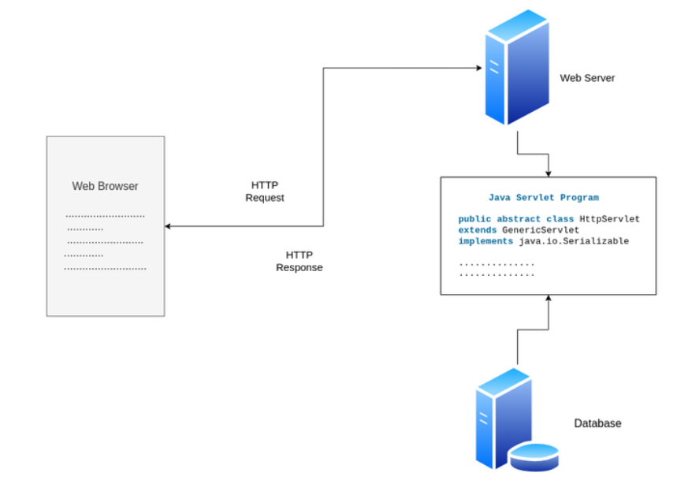

Slide 4
The Clients send the request to the Web Server.
The Web Server receives the request.
The Web Server passes the request to the corresponding servlet.
The Servlet processes the request and generates the response in the form of output.
The Servlet sends the response back to the webserver.
The Web Server sends the response back to the client and the client browser displays it on the screen.

Slide 5
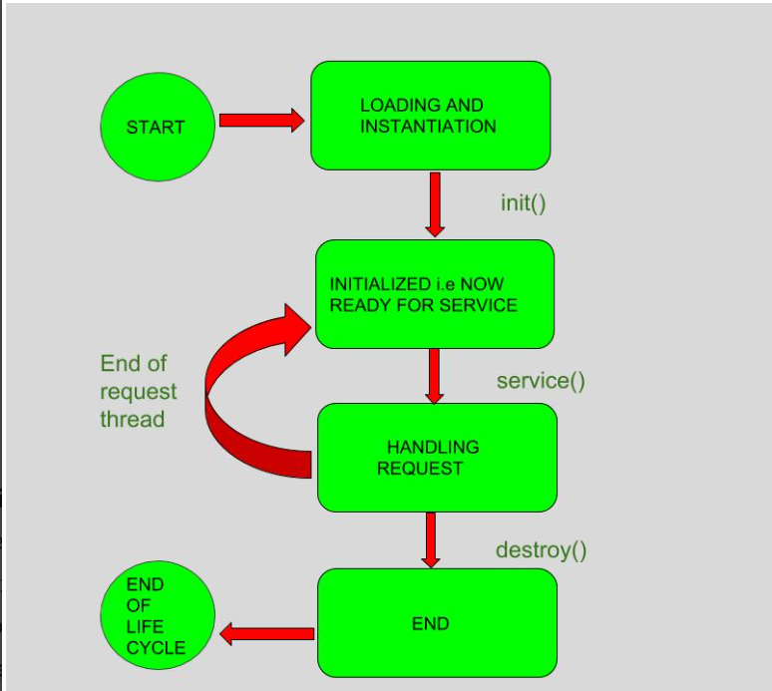
SERVLET LIFE CYCLE

Slide 6
SERVLET LIFE CYCLE
Loading : Loads the Servlet class.
Instantiation : Creates an instance of the Servlet. To create a new instance of the Servlet, the container uses the no-argument constructor.
Initializing a Servlet: After the Servlet is instantiated successfully, the Servlet container initializes the instantiated Servlet object. The container initializes the Servlet object by invoking
  the Servlet.init(ServletConfig) method which accepts ServletConfig object reference as parameter.The Servlet container invokes the Servlet.init(ServletConfig) method only once, immediately after the Servlet.init(ServletConfig) object is instantiated successfully. This method is used to initialize the resources, such as JDBC datasource.

Slide 7
SERVLET LIFE CYCLE
Handling request: After initialization, the Servlet instance is ready to serve the client requests. The Servlet container performs the following operations when the Servlet instance is located to service a request :It creates the ServletRequest and ServletResponse objects.
  In this case, if this is a HTTP request, then the Web container creates HttpServletRequest and HttpServletResponse objects which are subtypes of the ServletRequest and ServletResponse objects respectively.
  After creating the request and response objects it invokes the Servlet.service(ServletRequest, ServletResponse) method by passing the request and response objects.
  The service() method while processing the request may throw the ServletException or UnavailableException or IOException

Slide 8
SERVLET LIFE CYCLE
Destroying a Servlet: When a Servlet container decides to destroy the Servlet, it performs the following operations,
  It allows all the threads currently running in the service method of the Servlet instance to complete their jobs and get released.
  After currently running threads have completed their jobs, the Servlet container calls the destroy() method on the Servlet instance.
  After the destroy() method is executed, the Servlet container releases all the references of this Servlet instance so that it becomes eligible for garbage collection.

Slide 9
Servlets APIs
Servlets are built from two packages:
  javax.servlet(Basic)
  javax.servlet.http(Advance)
Contains 20 interfaces and 16 classes
Various classes and interfaces present in these packages are:
Server implemented interfaces
  ServletConfig
  ServletContext
  ServletRequest
  ServletResponse
  RequestDispatcher
  FilterChain
  FilterConfig
User implemented interfaces
  Servlet
  ServletContextListener
  ServletContextAttributeListener
  SingleThreadModel
  Filter

Slide 10
Servlets APIs
Servlet Classes
  GenericServlet
  ServletContextEvent
  ServletContextAttriubuteEvent
  ServletInputStream
  ServletOutputStream
  ServletRequestWrapper
  ServletResponseWrapper
Exception Classes
  ServletException
  UnavailableException
* Methods
  LifeCycle Methods
    init()
    service()
    destroy()
  Environment Methods
    getServletContext()
    getInitParameter(…)
    getInitParameterNames()

Slide 11
Tomcat for Servlet Development
Tomcat is a lightweight, easily configurable free web server and is widely used by users who are new to servlets.
install and configure the Tomcat web server.

Slide 12
Simple Servlet program
import java.io.*;
import javax.servlet.*;
import javax.servlet.http.*;
public class HelloWorldServlet extends HttpServlet {
public void doGet(HttpServletRequest request, HttpServletResponse response)
throws IOException, ServletException {
response.setContentType("text/html");
PrintWriter out = response.getWriter();
out.println("<html><head><title>Hello World Servlet</title></head>");
out.println("<body>");
out.println("<h1>Hello World!</h1>");
out.println("</body></html>");
out.close();
}
}

Slide 13
PASSING PARAMETERS TO SERVLETS
Like command line arguments, parameters can be passed to servlets.
Servlets can access those parameters and customize their tasks.
This helps servlets to function differently in different situations without recompiling the source code.
There are two ways in which you can pass parameters to a servlet: using URL and using HTML form.

Slide 14
PASSING PARAMETERS TO SERVLETS
Parameters can be passed to servlets directly using URL.
In this case parameters and their values are attached directly to the URL when you use the URL to call the servlet.
The URL and parameters are separated by ‘?’ character. The character ? says “here are the parameters”. Each parameter takes the form name=value. Multiple parameters are separated by the ‘&’ character.
Example:
http://172.16.5.81:8080/net/servlet/check?login=abc&password=xyz
Certain special characters such as space and quote (“) are not allowed directly in the URL. These characters are encoded in the %hh format where hh is the hex code of the character. For example, %20, %22, and %7E represent the space, quote, and tilde (~) characters, respectively.

Slide 15
PASSING PARAMETERS TO SERVLETS
disadvantages of passing parameters using URLs is that users can view the parameter names with their values passed and the number of parameters that we can pass is also limited.
HTML forms can be used to pass parameters in a convenient way
<form method='post' action='http://172.16.5.81:8080/net/servlet/check'>
Login:<input type='text' name='login'><br />
Password:<input type='password' name='password'><br/>
<input type='submit' value='Login'>
</form>

Slide 16
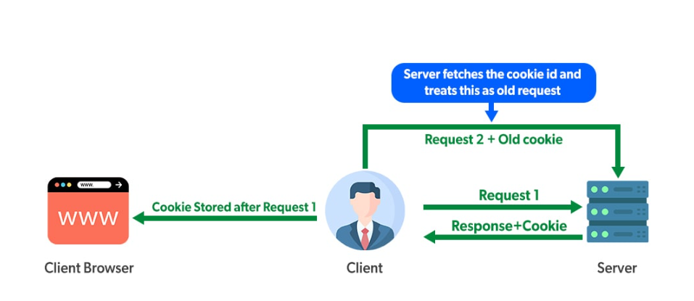
Cookies in Servlet
Cookies are the textual information that is stored in key-value pair format to the client’s browser during multiple requests.
the server treats every client request as a new one so to avoid this situation cookies are used
When the client generates a request, the server gives the response with cookies having an id which are then stored in the client’s browser.
Thus if the client generates a second request, a cookie with the matched id is also sent to the server.
The server will fetch the cookie id, if found it will treat it as an old request otherwise the request is considered new.

Slide 17
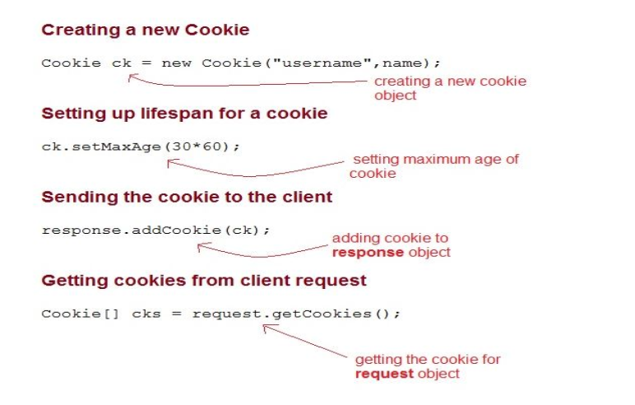
Cookies in Servlet
In order to use cookies in java, use a Cookie class that is present in javax.servlet.http package.

Slide 18
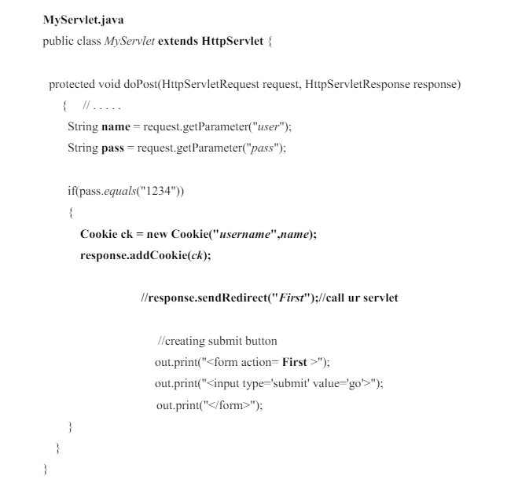
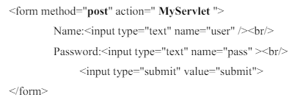
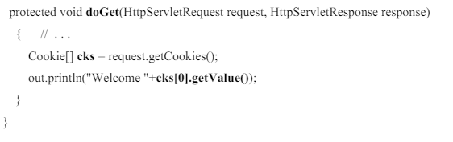
Cookies in Servlet
Index.html
First.java
Public class First extends HttpServlet {

Slide 19
Cookies in Servlet
clone(): Overrides the standard java.lang.Object.clone method to return a copy of this Cookie.
getComment(): Returns the comment describing the purpose of this cookie, or null if the cookie has no comment.
getDomain(): Gets the domain name of this Cookie.
getMaxAge(): Gets the maximum age in seconds of this Cookie.
getName(): Returns the name of the cookie.
getPath(): Returns the path on the server to which the browser returns this cookie.
getSecure(): Returns true if the browser is sending cookies only over a secure protocol, or false if the browser can send cookies using any protocol.
getValue(): Gets the current value of this Cookie.
getVersion(): Returns the version of the protocol this cookie complies with.
setValue(String newValue): Assigns a new value to this Cookie.
setVersion(int v): Sets the version of the cookie protocol that this Cookie complies with.

Slide 20
JSP
JSP stands for Jakarta Server Pages(JSP; formerly Java Server Pages).
It is a server-side technology which is used for creating web applications. It is used to create dynamic web content.
SP consists of both HTML tags and JSP tags.
In this, JSP tags are used to insert JAVA code into HTML pages.
It is an advanced version of Servlet Technology i.e. a web-based technology that helps us to create dynamic and platform-independent web pages
JSP is first converted into a servlet by the JSP container before processing the client’s request.

Slide 21
JSP
How JSP more advantageous than Servlet?
  They are easy to maintain.
  No recompilation or redeployment is required.
  Less coding is required in JSP.
  JSP has access to the entire API of JAVA.
  JSP are extended version of Servlet.

Slide 22
JSP
Features of JSP
  Coding in JSP is easy : As it is just adding JAVA code to HTML/XML.
  Reduction in the length of Code : In JSP we use action tags, custom tags etc.
  Connection to Database is easier : It is easier to connect website to database and allows to read or write data easily to the database.
  Make Interactive websites : In this we can create dynamic web pages which helps user to interact in real time environment.
  Portable, Powerful, flexible and easy to maintain : as these are browser and server independent.
  No Redeployment and No Re-Compilation : It is dynamic, secure and platform independent so no need to re-compilation.
  Extension to Servlet : as it has all features of servlets, implicit objects and custom tag

Slide 23
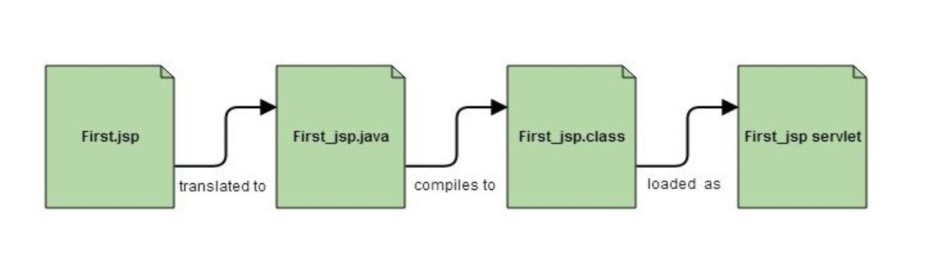
JSP
JSP life cycle
the JAP pages follows 3 phases:
  Initialization (jspInit() methos is used to invoke by container).
  Request Processing (jspService() method is invoked).
  Destroy (jspDestroy() method is invoked).

Slide 24
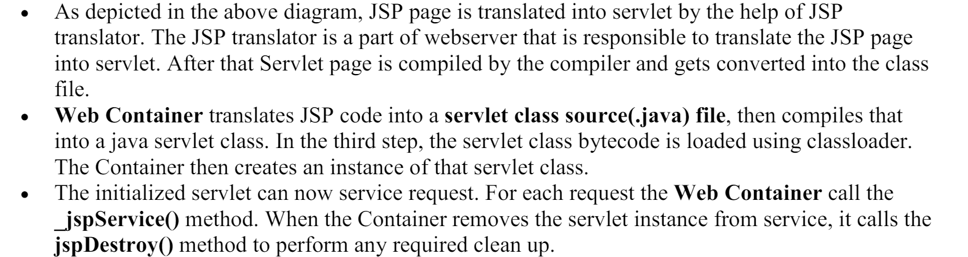
JSP

Slide 25
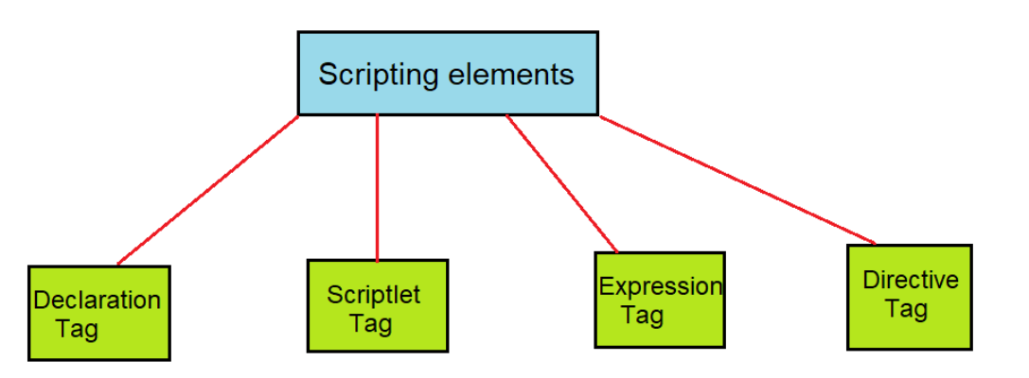
JSP
There are five different types of scripting elements:

Slide 26
JSP scriptlet tag
JSP scriptlet tag A scriptlet tag is used to execute java source code in JSP.
Syntax:
<% java source code %>
In this example, we are displaying a welcome message.
<html>
<body>
<% out.print("welcome to jsp"); %>
</body>
</html>

Slide 27
JSP scriptlet tag
Example of JSP scriptlet tag that prints the user name
Index.html <html> <body> <form action="welcome.jsp"> <input type="text" name="uname"> <input type="submit" value="go"><br/> </form> </body> </html> | Welcome.jsp <html> <body> <% String name=request.getParameter("uname"); out.print("welcome "+name); %> </form> </body> </html>

Slide 28
JSP Declaration Tag
The JSP declaration tag is used to declare variables, objects and methods.
The code written inside the jsp declaration tag is placed outside the service() method of auto generated servlet
Syntax:
<%! field or method declaration %>

Slide 29
  Example:
  <html>
  <body>
  <%! int data=50; %>
  <%= "Value of the variable is:"+data %>
  </body>
  </html>
<html>
<body>
<%!
int cube(int n){
return n*n*n*;
}
%>
<%= "Cube of 3 is:"+cube(3) %>
</body>
</html>

Slide 30
JSP Expression Tag
Expression Tag is used to print out java language expression that is put between the tags.
An expression tag can hold any java language expression that can be used as an argument to the out.print() method.
Syntax of Expression Tag
    <%= JavaExpression %>
Example:
<%= (2*5) %>
Example
<html>
<body>
<%= "welcome to jsp" %>
</body>
</html>

Slide 31
JSP Expression Tag
Welcome.jsp
<html>
<body>
<%= "Welcome "+request.getParameter("uname") %>
</body>
</html>
Index.html
<html>
<body>
<form action="welcome.jsp">
<input type="text" name="uname"><br/>
<input type="submit" value="go">
</form>
</body>
</html>

