Slide 1
Collection Framework : Objective
1.Ability to understand collection framework and its types.
2. Ability to understand different types of Lists with examples.
3. Ability to understand types of Sets with examples.
4. Ability to understand types of Maps with examples.
5. Ability to understand List, Set and Queue.
6. Ability to understand IterAbility Interface, Collection Interface and Iterator Interface.

Slide 2
Required Software
# Java 17 or 11+
# Intellj IDEA
# MySQL
# Postman

Slide 3
Java Collection
It is framework that provides an architecture to store and manipulate a group of objects.
It can achieve all the operation that you can perform on a dataset, such as sorting, searching, insertion etc.
It contains three parts: Interface, Implementation and Algorithms.

Slide 4
What is framework?
It provides ready-made architecture
It represent a set of class and interface
Collection framework is going to give everything you required in terms of data storage or data structures.

Slide 5
Java collection framework provides many interfaces and classes:
Interfaces
Set
List
Queue
Deque
Classes
ArrayList
Vector
LinkedLIst
HashSet

Slide 6
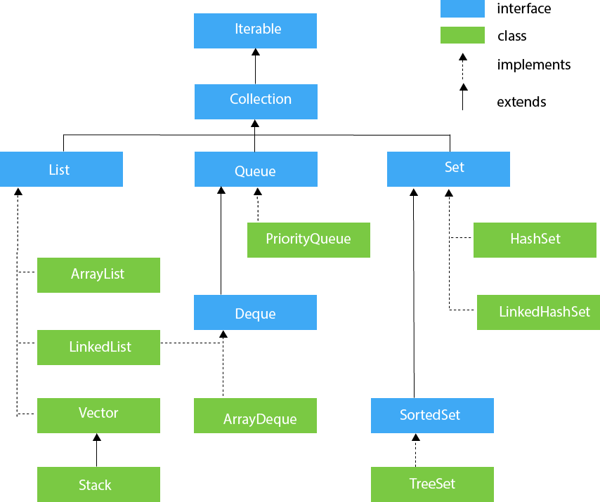
Collection Framework Hierarchy

Slide 7
Iterable interface
It is the root interface for all collection classes.
It provides the facility of iterating the element in a forward direction only.
hasNext() - it will return true if the iterator has more elements otherwise it return false. (used for iterating on the arrays)
next() - it will return the element and move the cursor pointing to the next element
remove() - it remove the last element returned by the iterator

Slide 8
Collection interface
It is the interface implemented by all the classes in the collection framework
It declared the method that every collection will have
It is responsible for building the foundation on which the collection framework depends.
- all()
- addAll()
- clear()
etc

Slide 9
List interface
List interface is the child interface of collection interface.
It provides a list type data structure in which we can store the ordered collection of the object.
It can have duplicate value.
Implemented by the following classes:
ArrayList
LinkedList
Vector
Stack
All these classes can be found in “java.util package”

Slide 10
Arrays vs. ArrayList
Arrays are fixed sized and ArrayList are dynamic.
Arrays are type safe and ArrayList are not.

Slide 11
ArrayList
ArrayList class use a dynamic array for storing the elements
It is like an array but there is no size limit
We can add or remove the elements anytime
It can have duplicate anytime
It implement list interface
It maintain the insertion order internally
It is non synchronized
Manipulation is a little slower then Linked List because a lot of shifting need to occur if any element is removed from the ArraytList

Slide 12
ArrayList Constructors
ArrayList()
ArrayList(int capacity) – initial size
ArrayList(collection)

Slide 13
ArrayList()
import java.util.ArrayList;
import java.util.Iterator;
public class Demo1
{
public static void main(String[] args)
{
ArrayList<String> mList = new ArrayList<>();
mList.add("Mark");
mList.add("Paul");
mList.add("Watson");
System.out.println(mList);
Iterator iterator = mList.iterator();
// hasNext() will check if the iterator has the element
while (iterator.hasNext())
{
System.out.println(iterator.next());
// print element and move the cursor to the next
}
// foreach
for(String name: mList)
{
System.out.println(name);
}
} }

Slide 14
get() & set() methods
import java.util.ArrayList;
public class Demo2
{
public static void main(String[] args)
{
ArrayList<String> names = new ArrayList<>();
names.add("Mark");
names.add("Paul");
names.add("John");
// get
System.out.println(names.get(1));
// set
names.set(1, "Paul Smith");
System.out.println("********");
for(String name: names)
{ System.out.println(name); } } }

Slide 15
import java.util.ArrayList;
import java.util.Collections;
public class Demo3 {
public static void main(String[] args) {
ArrayList<String> colors = new ArrayList<>();
colors.add("Yellow");
colors.add("Red");
colors.add("Orange");
colors.add("Blue");
colors.add("Pink");
// before sorting
System.out.println("before sorting..."); for(String color: colors) {
System.out.println(color);
}
// after sorting
Collections.sort(colors);
System.out.println("after sorting...");
for(String color: colors) {
System.out.println(color);
}
//Collections.sort(colors, Collections.reverseOrder());
// list of numbers
ArrayList<Integer> numbers = new ArrayList<>();
numbers.add(7);
numbers.add(2);
numbers.add(1);
numbers.add(5);
numbers.add(6);
// before sorting System.out.println("before sorting...");
for(int number: numbers)
{
System.out.println(number);
}
// after sorting
Collections.sort(numbers); System.out.println("after sorting..."); for(int number: numbers) {
System.out.println(number);
}
//Collections.reverse(numbers);
} }

Slide 16
Iterator Interface
for-each
for loop
forEach

Slide 17
import java.util.ArrayList;
import java.util.Iterator;
public class Demo4
{
public static void main(String[] args)
{
ArrayList<String> names = new ArrayList<>();
names.add("Mark");
names.add("John");
names.add("Watson");
names.add("Stacy");
// iterator
Iterator iterator = names.iterator();
while(iterator.hasNext())
{
System.out.println(iterator.next());
}
// for-each
for(String name: names)
{
System.out.println(name);
}
// for
for(int i=0;i< names.size();i++)
{
System.out.println(names.get(i));
}
//forEach
names.forEach(name -> System.out.println(name));
}
}

Slide 18
Complex List
Refer Demo5 program in the word document
Sorting a Complex List
Using Comparable or Comparator interface
Comparable interface
Use compareTo() method which return an integer value.
It is used to order the object of the user-define class.
This interface is found in java.lang package
It contain only one method by the name compareTo (other object)
Refer Demo6 program in the word document

Slide 19
public int compareTo(Other object)
This method is used to compare the current object with specified object and it return
positive - current object is greater than the specified object = 1
negative - current object is less than the specified object = -1
zero - current object is equal to the specified object = 0
sort() - sorting in ascending order
reverse() - sorting in descending order

Slide 20
Comparator Interface
Java comparator interface is used to order the object of a user define class
This interface in java.utl package and contain two methods
→compare(object obj1, object obj2)
→equal(object obj)

Slide 21
Linked List (Demo8)
Linked List class uses a doubly linkedList to store the elements
It provide a linkedList data structure, and it inherit the AbstractList class and implement the list and deque interface
LinkedList class can contain duplicate elements
It maintain insertion order
It is non-synchronized
In LinkedList manipulation is fast because no shifting need to occur
LinkedList class can be uses a list, stack or queue
doubly linked list - we can add or remove the elements from both side

Slide 22
ArrayList vs. LinkedList
ArrayList internally uses a dynamic array to store the element LinkedList internally uses a doubly LinkedList to store the element.
Manipulation is slow as sighting occurs manipulation is fast as no shifting required.
ArrayList is better for sorting and accessing data LinkedList is better for manipulating data.
ArrayList class can act as list only LinkedList can act as list and queue both.

Slide 23
// adding at specific index position
// adding two lists
// addFirst()
//addLast()
//remove()
//removeFirst()
//removeLast()
//removeFirstOccurance()
//removeLastOccurance()
//traversing the list element in reverse order

Slide 24
Set
Hashset
LinkedHashSet
TreeSet

Slide 25
Hashset (Demo9)
It is a class used to create a collection that uses a hash table for storage.
It inherit the AbstractSet class and implement the Set interface.
HashSet store the elements by using hashing mechanism.
It contain unique element only.
It allows a null value.
It is non synchronized.
It does not maintain the insertion order because the element are inserted on the basics of their hashCode
It is best for search operation.

Slide 26
TreeSet
The treeSet class implements the set interface that uses a tree for storage.
It inherit Abstract class and implements the Navigable set interface.
The object of the TreeSet class are stored on ascending order.
It contain unique elements only like hashset
It provides access and retrieval time are faster
It does not allow null element
It is non-synchronized
It maintain ascending order

Slide 27
Queue Interface
It is used to keep the elements that are processed in the FIFO (first in first out) manner.
It is an ordered list of objects, where insertion of elements occurs at the end of the list, and removal of elements occurs at the beginning of the list.

Slide 28
PriorityQueue Class
It is described that the insertion and deletion of objects follows FIFO pattern in java queue.
However sometime the elements of the queue are needed to be processed according to the priority and that's where PriorityQueue come into action.
//element()
//peek()
//remove()
//poll()

Slide 29
ArrayDeque Class
Unlike Queue, we can add or remove elements from both side.
Null elements are not allowed in the ArrayDeque
ArrayDeque is not thread safe
ArrayDeque has no capacity restrictions
ArrayDeque is faster then LinkedList and stack
Deque<string> queue = new ArrayDeque<>();
Interface Class
//offer()
//add()
//offerFirst()
//poll()

